Slide 1
MILLING
IE 262 Class Notes by Figen Eren

Slide 2
MILLING
Milling is another basic machining process by which surface is generated progressively by the removal of chips from a work piece as it is fed a rotating cutter.
Milling operations can be classified into two broad categories
1. Peripheral Milling
2. Face Milling
IE 262 Class Notes by Figen Eren

Slide 3
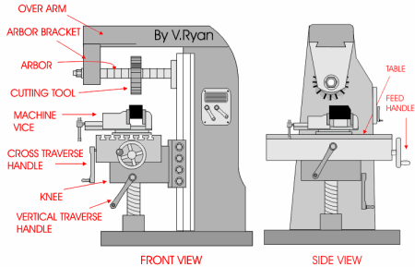
Peripheral Milling
IE 262 Class Notes by Figen Eren

Slide 4
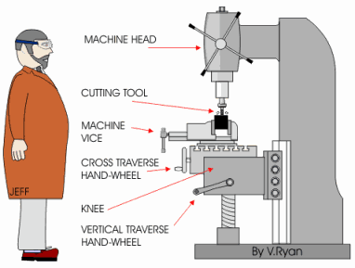
Face Milling
IE 262 Class Notes by Figen Eren

Slide 5
Peripheral Milling
The axis of the cutter rotation is parallel to the work piece surface to be machined in peripheral milling.
Slab milling:
Cutter width extends beyond the work piece on both sides
Slotting (Slot milling):
Cutter width is less than the work piece width, creating a slot. If the cutter is very thin, it can be used to cut a work part into two, called saw milling.
Side milling:
Cutter, machines the side of the work piece.
Straddle milling:
Similar to side milling, but cutting takes on both sides of the work part simultaneously.
IE 262 Class Notes by Figen Eren

Slide 6
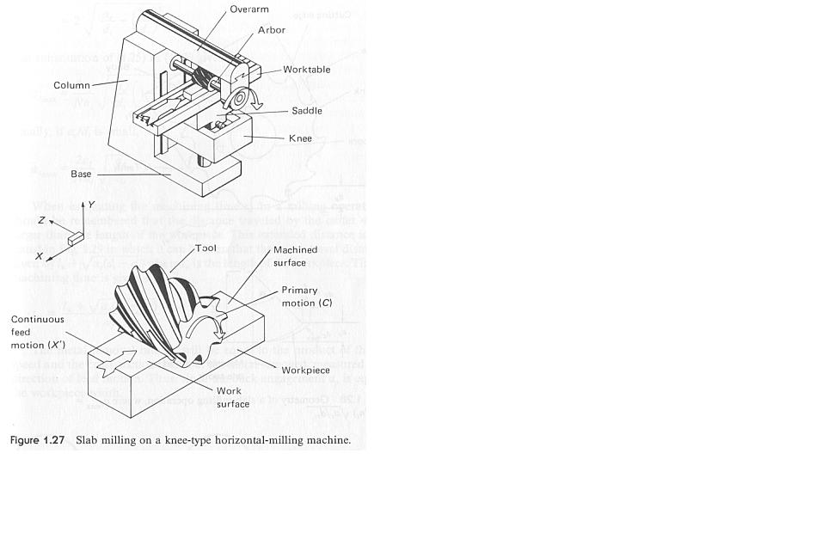
Slab milling
IE 262 Class Notes by Figen Eren

Slide 7
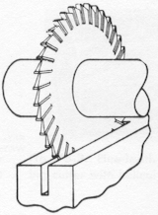
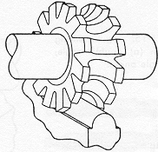
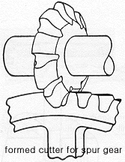
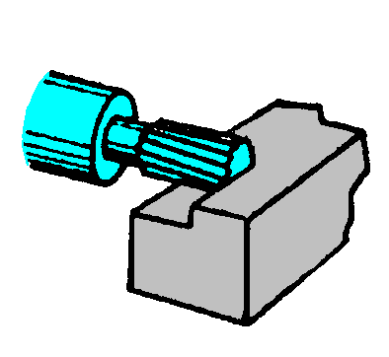
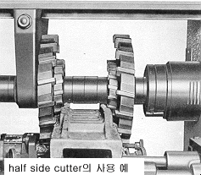
Slot milling
Form milling
Side milling
Straddle milling
IE 262 Class Notes by Figen Eren

Slide 8
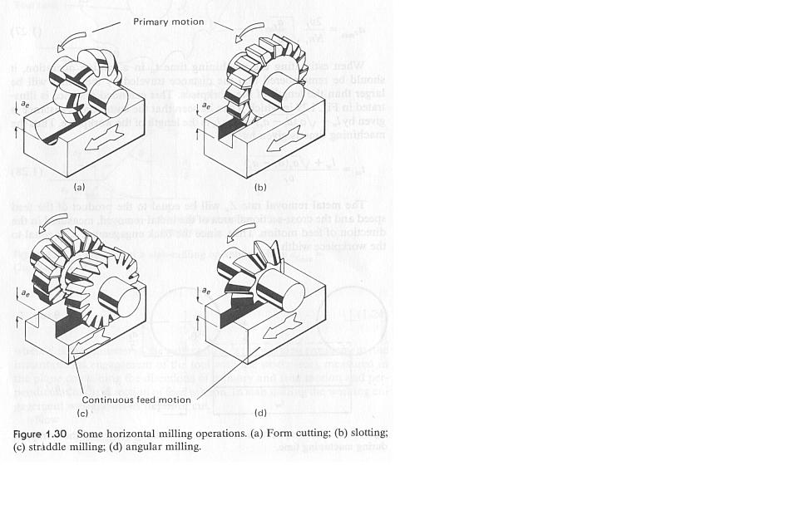
More Examples
IE 262 Class Notes by Figen Eren

Slide 9
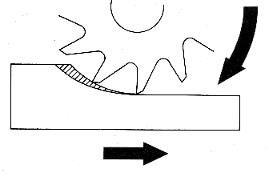
Up milling
Also called conventional milling,
- Wheel rotation opposite of the feed
- The chip formed by each cutter tooth starts out very thin and increases its thickness
- The length of the chip is relatively longer
- Tool life is relatively shorter
- Need more clamping force to hold the work part still.
IE 262 Class Notes by Figen Eren

Slide 10
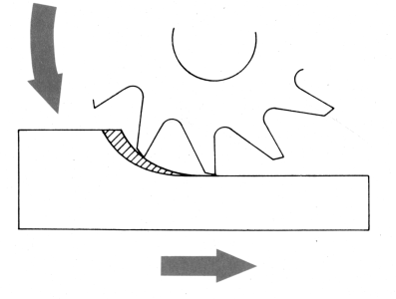
Down milling:
Also called climb milling,
- Wheel rotation is parallel to the feed
- The chip formed by each cutter tooth starts out thick and leaves out thin
- The length of the chip is relatively short
- Tool life is relatively longer
- Need less clamping force to hold the work part still.
IE 262 Class Notes by Figen Eren

Slide 11
Face Milling
The generated surface is at right angles to the cutter axis and is the combined result of actions of the portions of the teeth located on both periphery and the face of the cutter. Most of the cutting is done by the peripheral portions of the teeth, with the face portions providing some finishing actions.
Conventional face milling:
Diameter of tool is larger than work part’s width.
Partial face milling:
The cutter overhangs from one side of work part .
End milling:
Cutters diameter is less than the work part’s width.
IE 262 Class Notes by Figen Eren

Slide 12
Continue...
Profile milling:
Outside periphery of flat part is cut.
Pocket milling:
Similar to end milling, but the shape created is a shallow pockets in flat surfaces
Surface contouring:
A ball-nose cutter is fed back and forth across the work part to create a contoured surface perpendicular to the cutter.
IE 262 Class Notes by Figen Eren

Slide 13
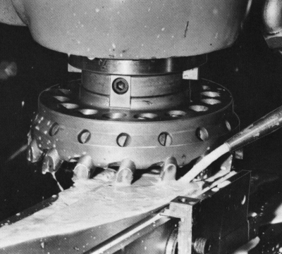

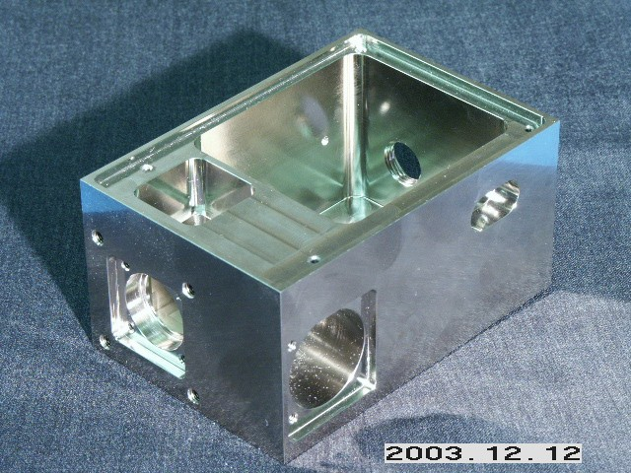

Face milling
Profile milling
Pocket milling
End milling
IE 262 Class Notes by Figen Eren

Slide 14
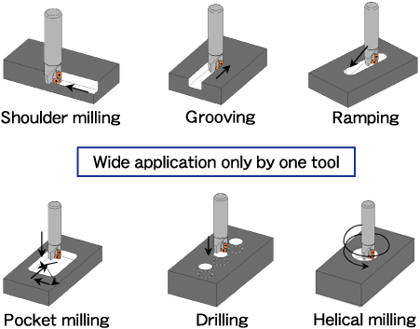
More Examples on Face Milling
IE 262 Class Notes by Figen Eren

Slide 15
Milling Cutters
The tool used in milling is known as a milling cutter, the cutting edges called teeth. Types of milling cutters are related to the milling operations can be classified as:
Plain milling cutters:
- Used in peripheral milling operations
- Cylindrical or disk shaped
- Have several straight or helical teeth on periphery
- Used to mill flat surfaces
Side milling cutters:
- Similar to plain milling cutters
- Teeth extend radial part way across one or both ends of cylinder toward the center
- Relatively narrow
IE 262 Class Notes by Figen Eren

Slide 16
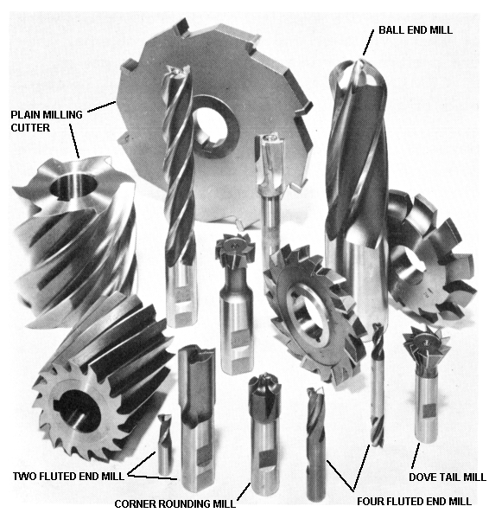
Milling Cutters
IE 262 Class Notes by Figen Eren

Slide 17
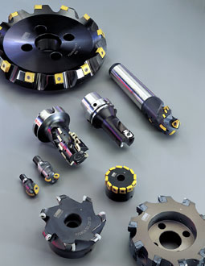
More Milling Cutters
IE 262 Class Notes by Figen Eren

Slide 18
Continue...
Form milling cutters:
- Another peripheral milling cutter
- Teeth ground to a special shape to produce a surface having a desired transverse contour, convex, concave shape.
End milling cutters:
- Looks like a drill bit, but it cuts with peripheral teeth instead of it’s end.
- Have multiple teeth
- Used in milling slots, profiling and facing narrow surfaces.
IE 262 Class Notes by Figen Eren

Slide 19
Continue...
Face milling cutters:
- Have teeth on periphery and both sides
- Made of HSS
T-slot cutters:
- Have teeth on periphery and both sides
- Used for milling the wide groove of a T-slot
- In order to use them, a vertical groove must first be made with a slotting mill or an end mill to provide a clearance for the shank
- T-slot cutter must be fed carefully, because it cuts in 5 surfaces
IE 262 Class Notes by Figen Eren

Slide 20
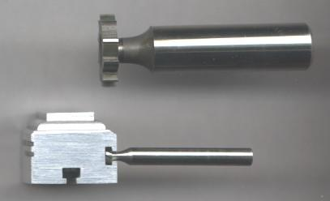
T-Slot Milling Cutters
IE 262 Class Notes by Figen Eren

Slide 21
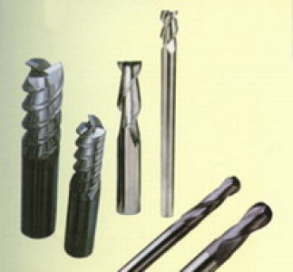
End Milling Cutters
IE 262 Class Notes by Figen Eren

Slide 22
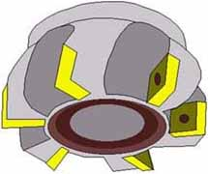
Face Milling Cutters
IE 262 Class Notes by Figen Eren

Slide 23
Milling Machines
The milling machine supplies an accurate rotating spindle for the cutter and a table (vise) to fix and position the work part. There are two types of machines
Horizontal milling machines:
- Horizontal spindle
- Designed for peripheral milling operations
Vertical milling machines:
- Vertical spindle
- Designed for face milling operations
(In our Lab.s we have this type of machines)
IE 262 Class Notes by Figen Eren

Slide 24
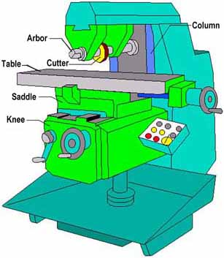
Horizontal Milling Machine
IE 262 Class Notes by Figen Eren

Slide 25
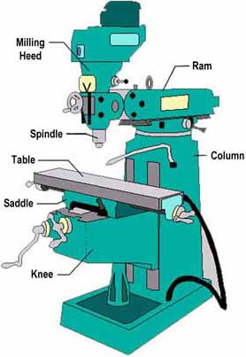
Vertical Milling Machine
IE 262 Class Notes by Figen Eren

Slide 26
Classifications of milling machines
Column and Knee type:
- General purpose
- Column, spindle, cutter, table, knee, base are the common parts of the vertical and horizontal milling machines
- In horizontal, arbor supports the cutter and an over arm supports arbor
- In vertical, milling cutters can be mounted directly in the spindle
- The milling machines having only the three mutually perpendicular table motions (x-y-z axes) are called plain column and knee type
-Vertical type is especially well suited for face and end milling operations
IE 262 Class Notes by Figen Eren

Slide 27
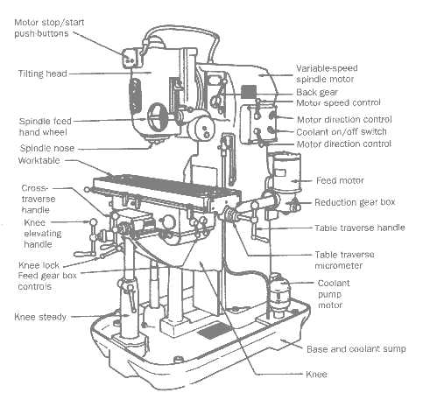
Column and Knee Milling Machine
IE 262 Class Notes by Figen Eren

Slide 28
Continue...
-Two more special column and knee machines are called universal and turret type.
Universal type:
Has a table that can be rotate in a horizontal plane to any specified angle
Turret type:
Has duel heads that can be rotated about a horizontal axis. This permits milling to be done horizontally, vertically or at any angle.
IE 262 Class Notes by Figen Eren

Slide 29
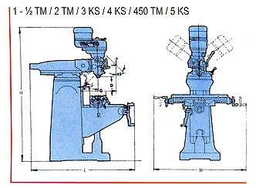
Turret Type Milling Machine
IE 262 Class Notes by Figen Eren

Slide 30
Continue...
Bed type milling machines:
- Designed for mass production
- Greater rigidity
- Achieves heavier feed rates and depth of cuts, high MRR
-Work table is directly fixed on the bed of the machine tool
The cutter mounted in a spindle head that can be adjusted vertically along the machine column
After machine set-up, little skill required to operate them, therefore semi-skill operators can us this type of machines
Three types are available w.r.t. the count of spindles available
Simplex:
Has single spindle
IE 262 Class Notes by Figen Eren

Slide 31
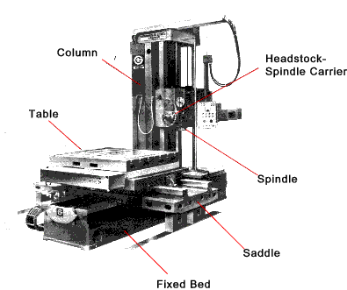
Bed Type Milling Machine(1)
IE 262 Class Notes by Figen Eren

Slide 32
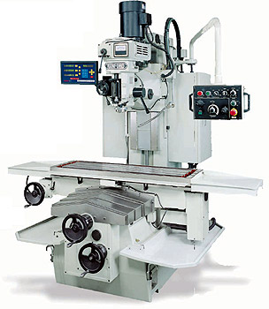
Bed Type Milling Machine(2)
IE 262 Class Notes by Figen Eren

Slide 33
Continue...
- Duplex:
Has two spindles, permitting simultaneous milling of two surfaces at a single pass
Triplex:
Has three spindles, permitting simultaneous milling of three surfaces at a single pass
Planer type milling machines:
- Utilize several milling heads
- Can remove large amount of metal while permitting the table and work piece to move quite slowly
- Often, only single pass is required
- Good for heavy pieces
IE 262 Class Notes by Figen Eren

Slide 34
Continue...
Tracer mills (Profiling milling machines):
- Also called duplicators
- Designed to reproduce an irregular part geometry that can be created on an template
- In two dimensions- tracer
- In three dimensions- duplicator
CNC milling machines:
- Cutter path controlled by numerical data
- Suited to profile, pocket, surface contouring.
IE 262 Class Notes by Figen Eren

Slide 35
CUTTING CONDITIONS IN MILLING
The rotational speed in milling is related to the desired cutting speed at the surface of the work piece by equation.
υ
N = -------------
π D
N= rotational speed, rev/min
υ = cutting speed, ft/min (m/min)
D= Tool diameter, ft (m)
IE 262 Class Notes by Figen Eren

Slide 36
CUTTING CONDITIONS IN MILLING(cont..1)
The rotational speed in milling is related to the desired cutting speed at the surface of the work piece by equation.
f _{r}= N.n _{t} . f
f _{r} = feed rate, in/min (mm/min)
f = chip load, in/tooth (mm/ tooth)
n _{t} = number of teeth on cutter
MRR= w. d. f _{r}
d = depth of cut, in (mm)
w = width of cut, in (mm)
IE 262 Class Notes by Figen Eren

Slide 37
SLAB MILLING:
L+A
T _{m} = --------------------
f _{r}
A : Approach distance to reach full cutter depth
A = √d.(D-d)
T _{m}: Machining time, min
IE 262 Class Notes by Figen Eren

Slide 38
FACE MILLING:
L+2.A
T _{m} = --------------------
f _{r}
A : Approach distance to reach full cutter depth
A = √w.(D-w): For partial Face milling
A = D/2 : For conventional Face milling
IE 262 Class Notes by Figen Eren

